Slide 1
MACHINE LEARNING
KOWCIKA A
Asst Prof
Dept of CSE
RVCE

Slide 2
Intelligence
Intelligence
Ability to solve problems
Examples of Intelligent Behaviors or Tasks
Heart disease diagnosis
Chess playing

Slide 3
Example 1: Disease Diagnosis (1)
Patient 1’s data
Age: 67
Sex: male
Chest pain type: asymptomatic
Resting blood pressure: 160mm Hg
Serum cholestoral: 286mg/dl
Fasting blood sugar: < 120mg/dl
…
Doctor Diagnosis
Presence

Slide 4
Example 1: Disease Diagnosis (2)
Patient 2‘s data
Age: 63
Sex: male
Chest pain type: typical angina
Resting blood pressure: 145mm Hg
Serum cholestoral: 233mg/dl
Fasting blood sugar: > 120mg/dl
…
Doctor Diagnosis
Absence

Slide 5
Example 2: Chess Playing
Chess Game
Two players playing one-by-one under the restriction of a certain rule
Characteristics
To achieve a goal: win the game
Interactive

Slide 6
Artificial Intelligence
Artificial Intelligence
Ability of machines in conducting intelligent tasks
Intelligent Programs
Programs conducting specific intelligent tasks
Intelligent Processing
Input
Output

Slide 7
Example 1: Disease Classifier (1)
Preprocessed data of patient 1
Age = 67
Sex = 1
Chest pain type = 4
Resting blood pressure = 160
Serum cholestoral = 286
Fasting blood sugar = 0
…
Classification
Presence = 1

Slide 8
Example 1: Disease Classifier (2)
Preprocessed data of patient 2
Age = 63
Sex = 1
Chest pain type = 1
Resting blood pressure = 145
Serum cholestoral = 233
Fasting blood sugar = 1
…
Classification
Presence = 0

Slide 9
Example 3: Chess Program
Searching and evaluating
Matrix representing the current board
Best move -New matrix
Opponent’s playing his move

Slide 10
Traditional Programming
Machine Learning
Data
Computer
Output
Program
Data
Computer
Program
Output

Slide 11
Machine Learning
Machine Learning (Mitchell 1997)
Learn from past experiences
Improve the performances of intelligent programs
Definitions (Mitchell 1997)
A computer program is said to learn from experience E with respect to some class of tasks T and performance measure P, if its performance at the tasks improves with the experiences

Slide 12
Example 1: Disease Diagnosis
Database of medical records
Patient 1’s data Absence
Patient 2’s data Presence
… …
Training
Disease classifier
New patient’s data
Presence or absence

Slide 13
Example 2: Chess Playing
Games played:
Game 1’s move list Win
Game 2’s move list Lose
… …
Training
New matrix representing the current board
Strategy of Searching and Evaluating
Best move

Slide 14
Types of Learning
Supervised (inductive) learning
Training data includes desired outputs
Unsupervised learning
Training data does not include desired outputs
Semi-supervised learning
Training data includes a few desired outputs
Reinforcement learning
Rewards from sequence of actions

Slide 15
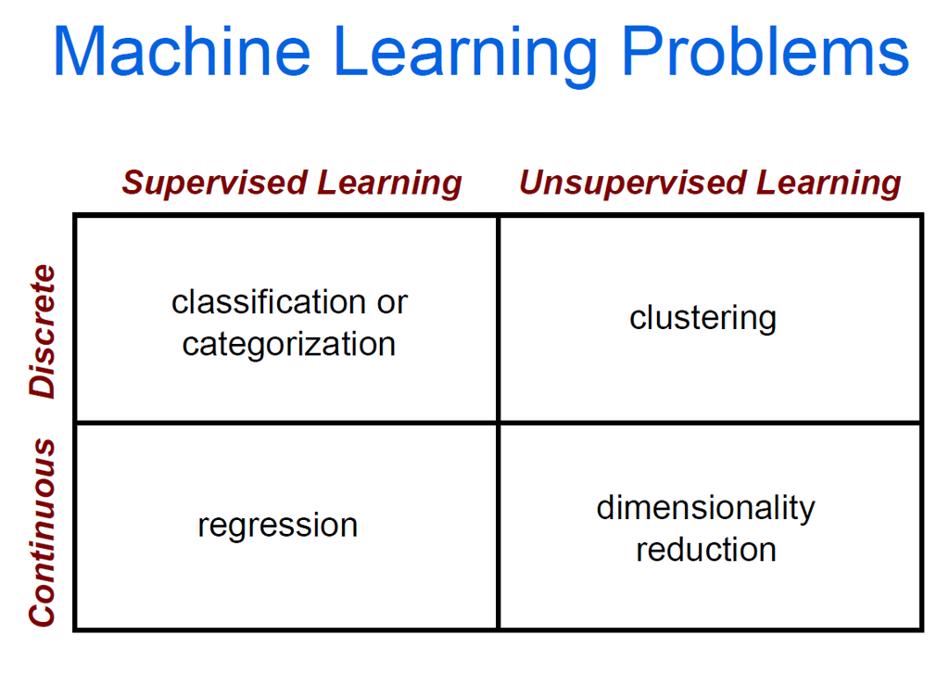

Slide 16
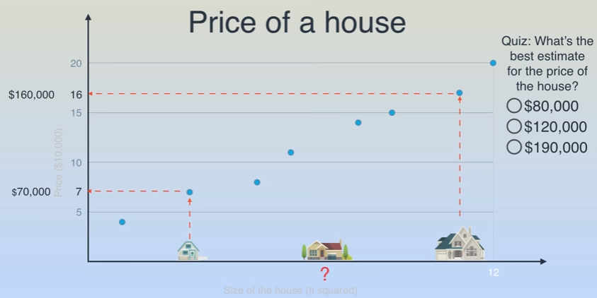
LINEAR REGRESSION

Slide 17
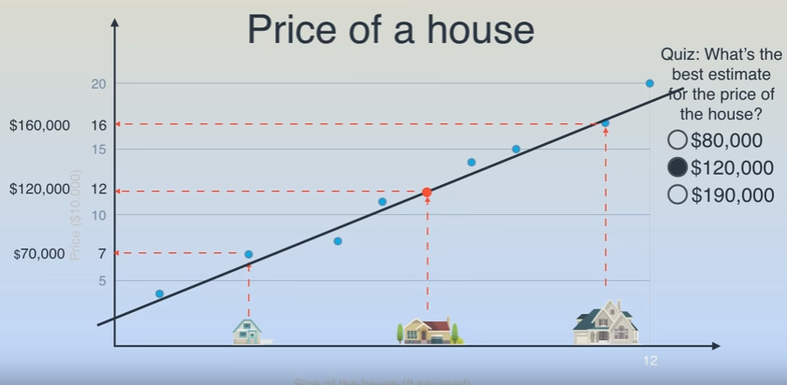

Slide 18
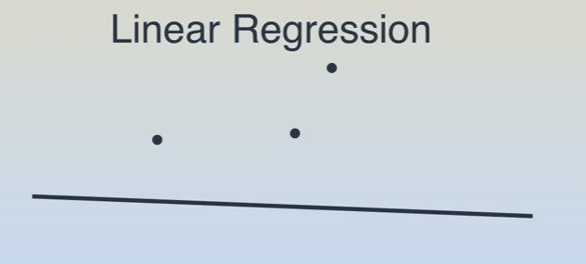
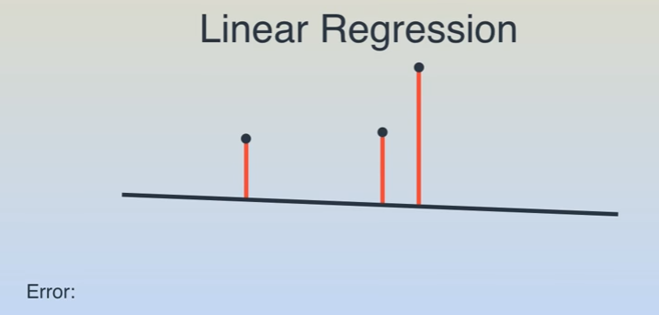
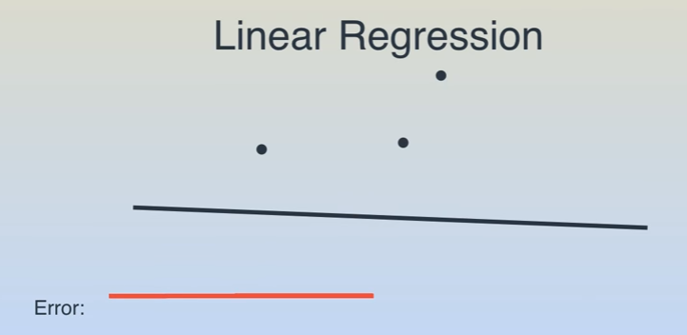

Slide 19
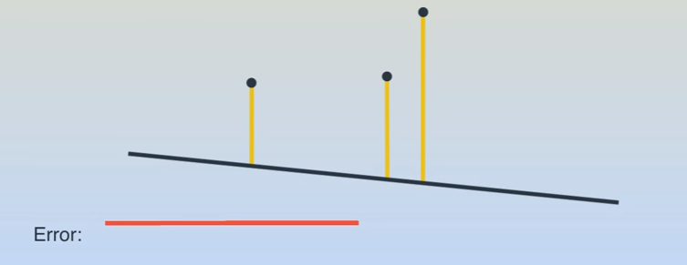
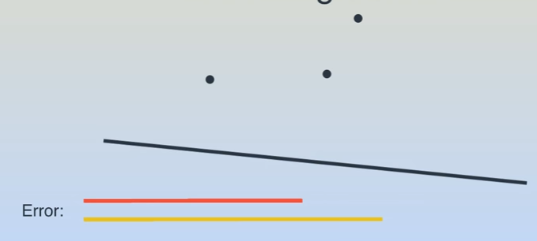
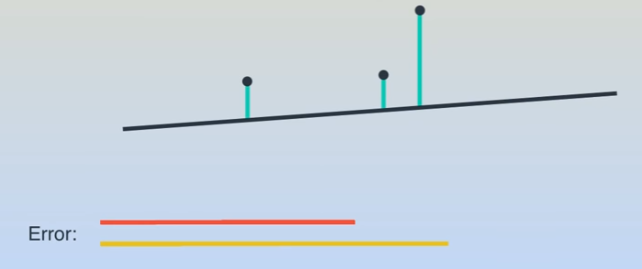
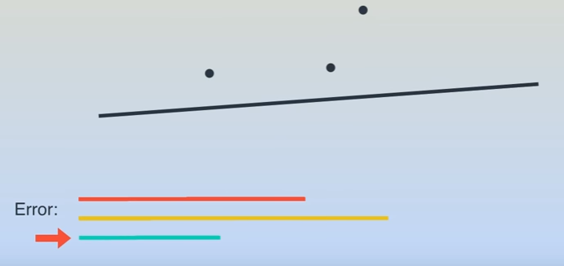

Slide 20
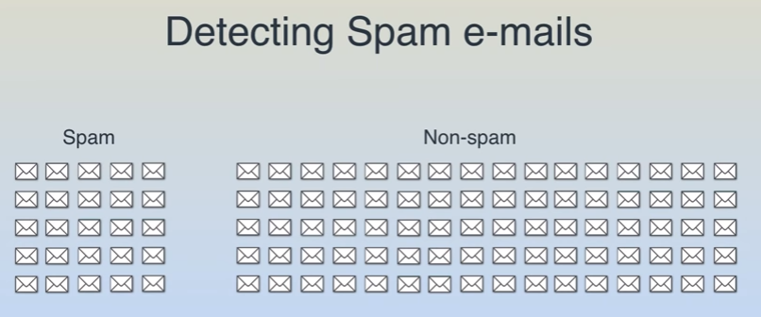
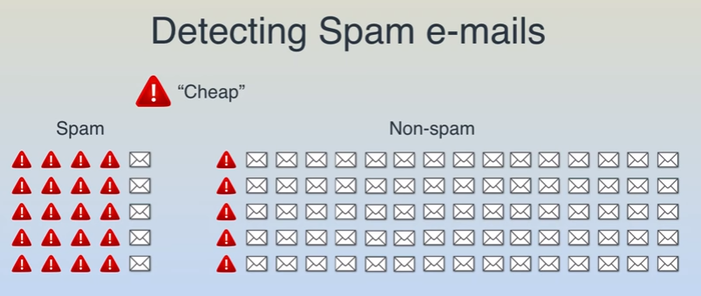
NAÏVE BAYES ALGORITHM

Slide 21
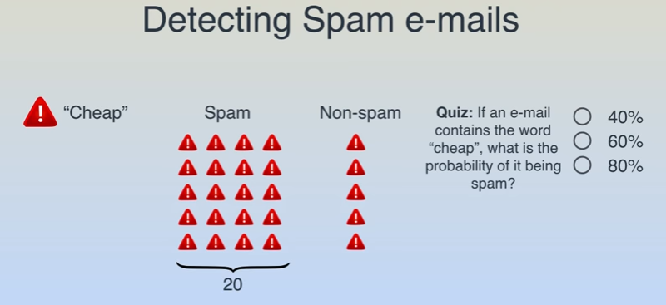

Slide 22
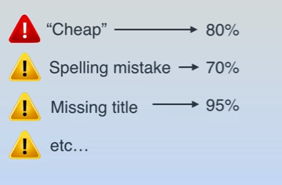

Slide 23
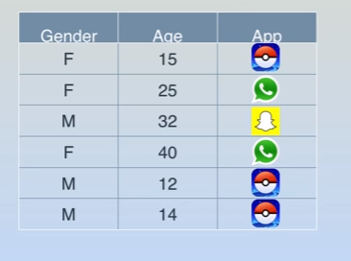
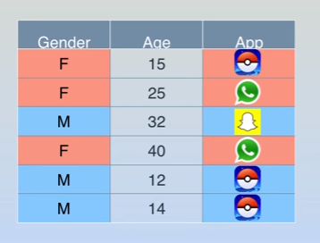
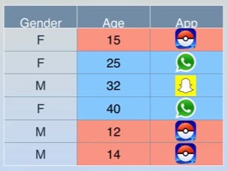
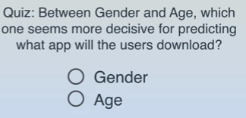
DECISION TREE

Slide 24
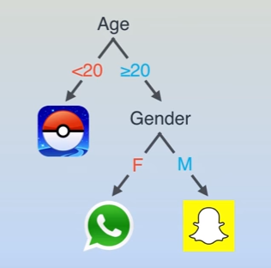

Slide 25

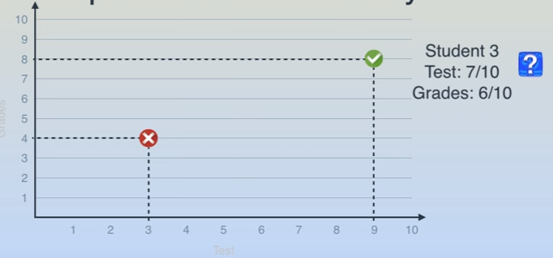
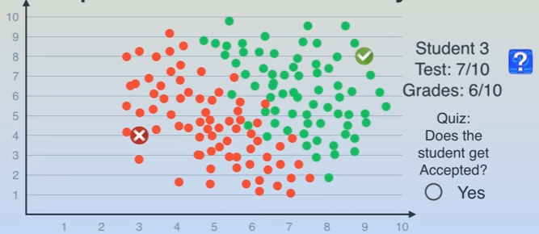

Slide 26
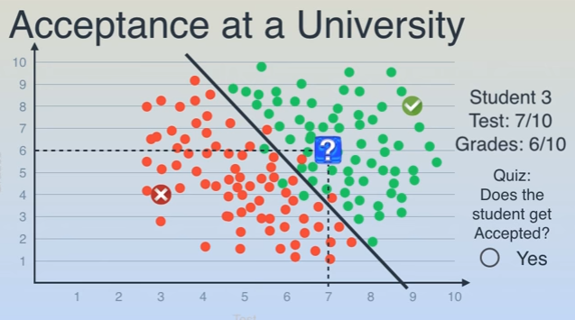
LOGISTIC REGRESSION

Slide 27
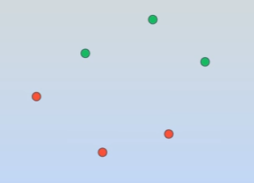
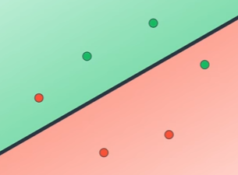
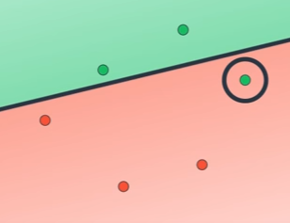
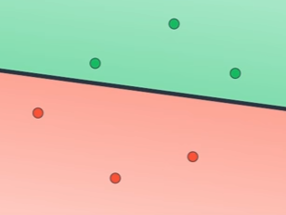

Slide 28
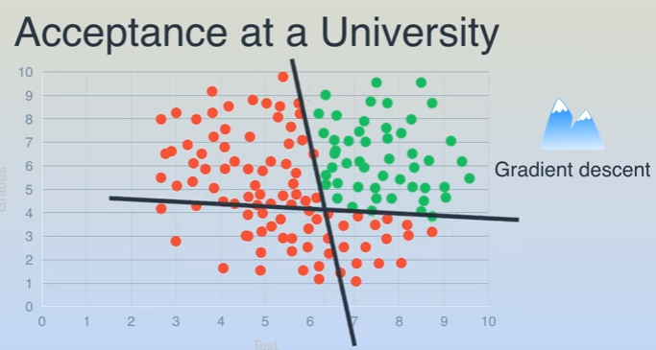
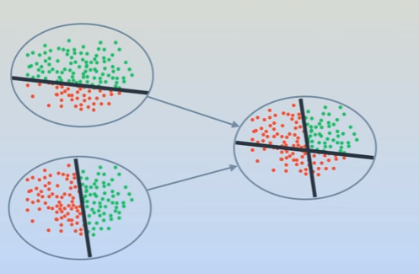
NEURAL NETWORK

Slide 29
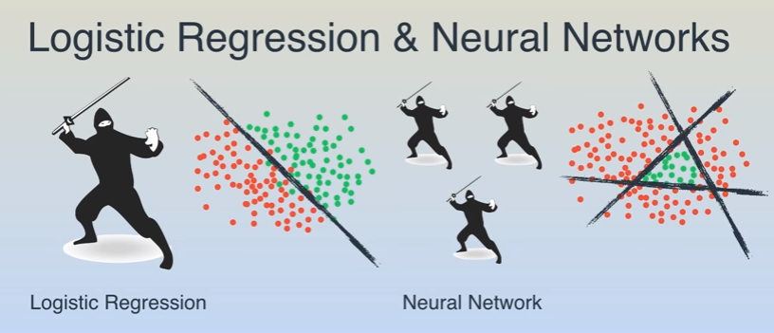

Slide 30
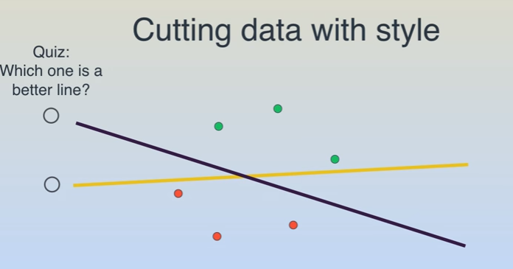
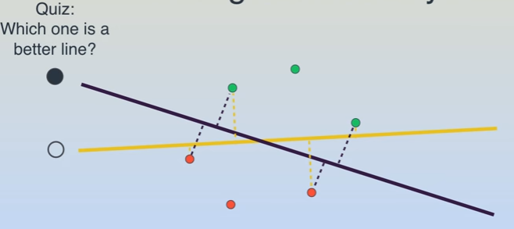

Slide 31
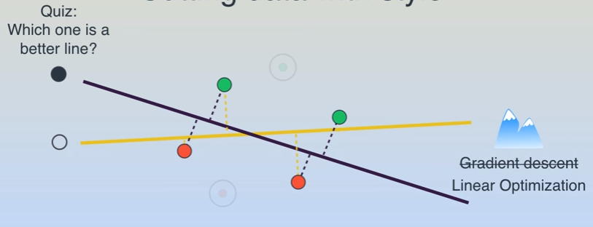
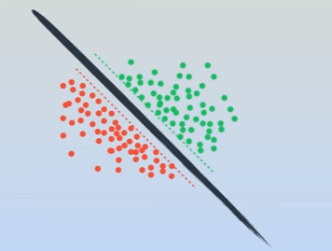

Slide 32
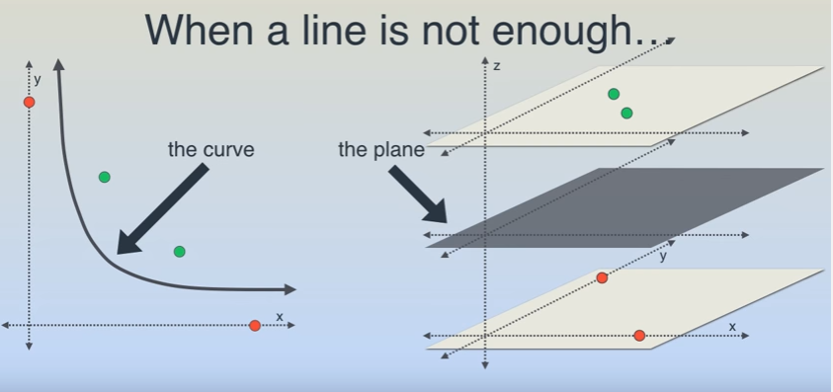
KERNEL TRICK

Slide 33
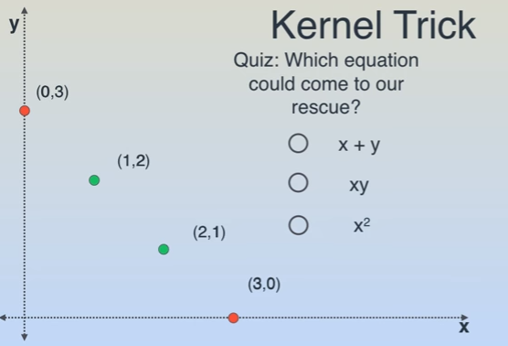
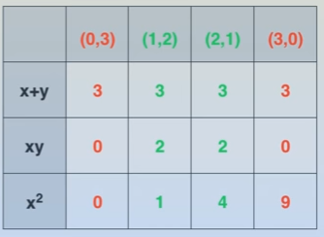

Slide 34
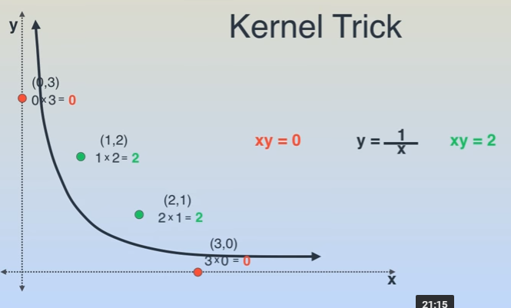
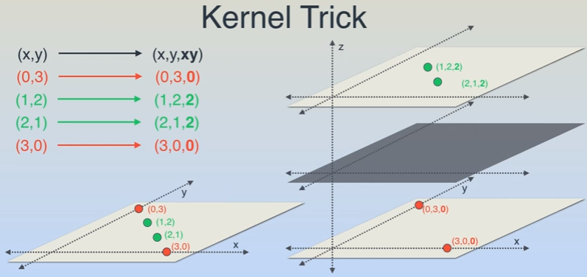

Slide 35
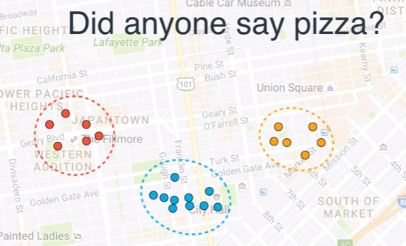
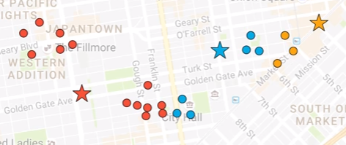
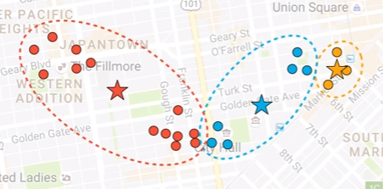
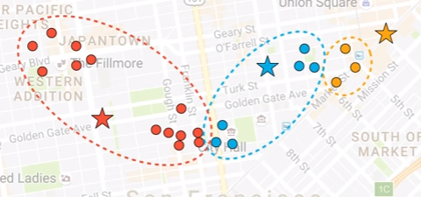
K MEANS CLUSTERING

Slide 36
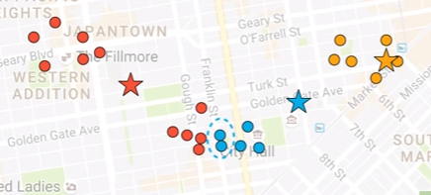
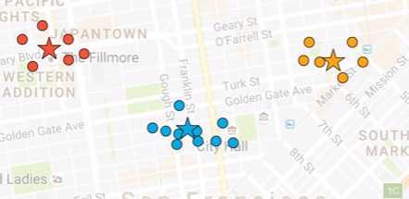

Slide 37
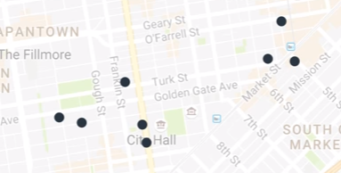
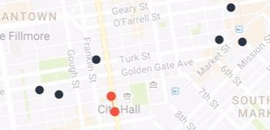
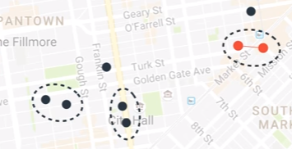
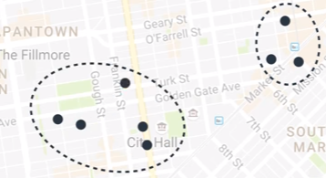
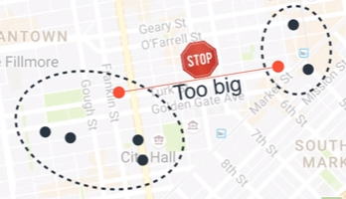
HIERARICHICAL CLUSTERING

Slide 38
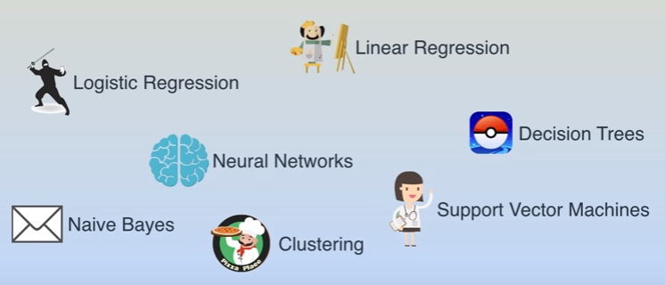

Slide 39
Algorithms
Supervised learning
Unsupervised learning
Semi-supervised learning

Slide 40

Machine learning structure
Supervised learning

Slide 41

Machine learning structure
Unsupervised learning

Slide 42
Learning techniques
Supervised learning categories and techniques
Linear classifier (numerical functions)
Parametric (Probabilistic functions)
Naïve Bayes, Gaussian discriminant analysis (GDA), Hidden Markov models (HMM), Probabilistic graphical models
Non-parametric (Instance-based functions)
K-nearest neighbors, Kernel regression, Kernel density estimation, Local regression
Non-metric (Symbolic functions)
Classification and regression tree (CART), decision tree
Aggregation
Bagging (bootstrap + aggregation), Adaboost, Random forest

Slide 43

Learning techniques
Linear classifier
Techniques:
Perceptron
Logistic regression
Support vector machine (SVM)
Ada-line
Multi-layer perceptron (MLP)
, where w is an d-dim vector (learned)

Slide 44
Learning techniques
Unsupervised learning categories and techniques
Clustering
K-means clustering
Spectral clustering
Density Estimation
Gaussian mixture model (GMM)
Graphical models
Dimensionality reduction
Principal component analysis (PCA)
Factor analysis

Slide 45
Applications
Face detection
Object detection and recognition
Image segmentation
Multimedia event detection
Economical and commercial usage

